Slide 1

Change Management
Policy and process
BCP and QMS Leader: Oz-bee Quinto
Quality Process Lead: Gem Santiago
Notes:
Good day everyone and welcome to IBM CIC Philippines’ training on Change Management Policy and Process presented by the Quality Management System Team.
For your information, IBM CIC Philippines’ Change Management Policy is aligned with IBM’s Global Quality Framework, which follows the ISO 9001:2015 requirements of the company.

Slide 2
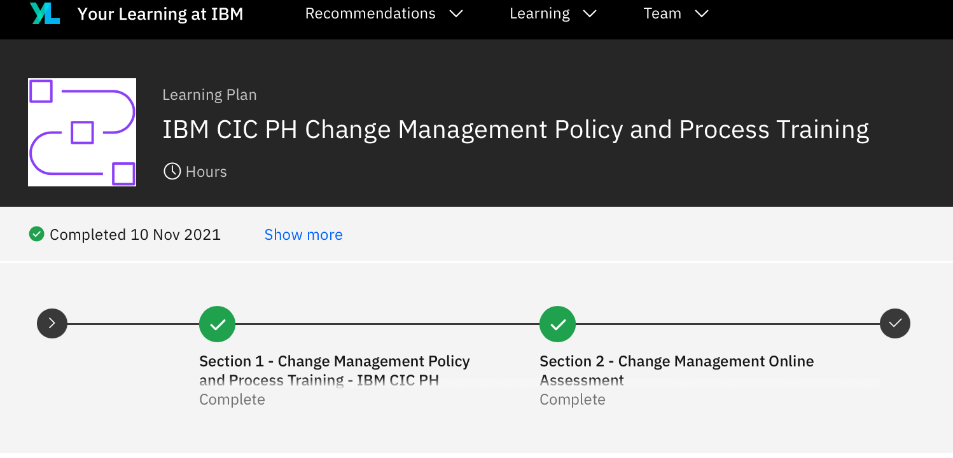

Reminders
Completion of Online Assessment. Link will be forwarded via email after the training.
Think40 credits will be provided to those who passed the assessment.
w3 Publisher Page: https://w3.ibm.com/w3publisher/qms
Notes:
Some reminders before we begin.
This training is part of the IBM CIC PH Change Management Policy and Process Learning Plan. To gain full understanding of this topic and complete Think40 credits, make sure that you also complete the post-training assessment after this course. The target passing rate for the post-training assessment is 85%.
The training materials and reference links are readily available from the w3 Publisher page of the QMS Team: w3.ibm.com forward slash w3publisher forward slash qms

Slide 3
Training objectives
1
Gain knowledge on Change Management policy and guidelines.
2
Understand the roles and responsibilities of IBM employees in proper handling of contract changes, and IBM-initiated process changes.
3
Be familiar with the change management workflow in MDC Percolator.
Notes:
During this training you will:
Gain knowledge on Change Management policy and guidelines.
Get to understand your roles and responsibilities as IBM employees in proper handling of contract changes, and IBM-initiated process changes.
And you will be familiar with the change management workflow embedded in our change management tool MDC Percolator.

Slide 4

Change Management
The Change Management process defines the proper handling of contract changes, and IBM-initiated process changes.
Changes may be raised:
  By IBM
  By the client
Notes:
The Change Management policy and process defines the proper handling of contract changes which may be raised or initiated by IBM or the client.

Slide 5


Change Management Objectives
To avoid the following risks:
IBM not being paid for work performed.
No protection of our intellectual property and no limitation on our liabilities.
Potential mismatch of IBM and Customer expectations, leading to disputes and low customer satisfaction.
To ensure that all contractual changes and IBM initiated changes are documented before execution.
Notes:
The change management policy and process ensures that all contractual and IBM-initiated changes are documented before execution.
This objective helps avoid the following risks in case of no documented agreement between IBM and the client of a new or added scope or process:
IBM not being paid for work performed
No protection of IBM’s intellectual properly and no limitation on IBM’s liabilities
And potential mismatch of IBM and customer expectations which may lead to disputes and customer dissatisfaction

Slide 6

Major Changes
Change in existing contract
Ex. Addition/deletion of process
Change in Process as a result of process improvement
Ex. Automation, process re-engineering
Required to be logged in
MDC Percolator
Work at Risk
Work or process being executed that is not covered by an existing contract, and with no signed PCR.
  Ex.
  Hiring of employees already started without an existing approved contract
  Employees traveling for KT without approved contract
  Process executed outside of the contract with impact to cost or revenue baseline
Notes:
Over time your original processes will evolve.
To provide guidance on how to properly manage your process changes, we have identified two types of Process Changes.
Major Changes are those that fall under a change to your existing contract like addition or deletion of a process. These changes are also commonly due to process improvement initiatives like automation projects or process re-engineering.
Any work or process being executed that is not yet covered by an existing contract or with no signed Process Change Request or PCR yet but with impact to cost or revenue baseline are also considered a Major Change under Work at Risk. An example of Work at Risk is hiring of employees pending the final approval of the contract.
These Major Changes are required to be logged in the MDC Percolator tool.

Slide 7
Minor Changes
Simple Change/s in Process Flow
  Ex. Change in hyper-link, change in template attachment, correction of text in DTP, etc.
Not required to be logged in MDC Percolator
Ad hoc Requests
  Ex. One-time request only, non-recurring, and not needed on a regular basis.
Notes:
Minor changes are the simple updates to your process like changes to links, templates or forms. These types of changes do not alter the actual steps of your process.
Ad hoc Requests or one-time requests from the client are also considered a minor process change. However, if these ad hoc requests become a regular requirement, inform your leads so they can determine if this should already be flagged as a major change.
Minor process changes are not required to be logged in the MDC Percolator tool.

Slide 8

KNOWLEDGE CHECK
What is the tool used for logging specific process changes?
QMX
MDC Percolator
w3 Page
Box@IBM
IBM Notes
Notes:
We’ll now have a series of knowledge checks to confirm your understanding of the topic.
Question 1:
What is the tool used for logging specific process changes?
Is it –
QMX
MDC Percolator
W3 Page
Box@IBM
IBM Notes

Slide 9

KNOWLEDGE CHECK
What is the tool used for logging specific process changes?
B. MDC Percolator
The MDC Percolator tool hosts separate dashboards per tower which accounts should access to log, monitor, and store their process changes.
Notes:
The correct answer is B. MDC Percolator, which is a web-based tool that hosts separate dashboards per tower which accounts should access to log, monitor, and store their process changes.

Slide 10
KNOWLEDGE CHECK
Change can be only triggered or initiated by the client.
True
False
Notes:
Question number 2, true or false.
Change can be only triggered or initiated by the client.

Slide 11
KNOWLEDGE CHECK
Change can be only triggered or initiated by the client.
B. False
Either IBM or the Client can initiate a process change.
Notes:
The answer is False. Either IBM or the client themselves can initiate a process change.

Slide 12
KNOWLEDGE CHECK
The term PCR stands for?
Pre-creation records
Process Change Request
Process Change Reform
None of the above
Notes:
Third question. The term PCR stands for what?
A. Pre-creation records
B. Process Change Request
C. Process Change Reform
D. None of the above

Slide 13
KNOWLEDGE CHECK
The term PCR stands for?
B. Process Change Request
A Process Change Request is a document signed by both IBM and the Client that contains all important details about a process change.
Notes:
The answer is B, Process Change Request.
A PCR is a document signed by both IBM and the Client that contains all important details about a process change.
Account PMOs owns and manages the contract with the client, and they process all PCRs.

Slide 14
KNOWLEDGE CHECK
What is considered a major process change?
Addition or Deletion of process
Work at Risk
Automation Projects
None of the above
All of the above
Notes:
Question number 4. What is considered a major process change?
Addition/ Deletion of process
Work at Risk
Automation Projects
None of the above
All of the above

Slide 15
KNOWLEDGE CHECK
What is considered a major process change?
E. All of the Above
Changes to the existing contract, a process to be executed outside of the existing contract, as well as changes in the process as a result of a process improvement initiative are considered major changes.
Notes:
The answer is E, all of the above.
Changes to the existing contract, a process to be executed outside of the existing contract, as well as changes in the process as a result of a process improvement initiative are considered major changes.

Slide 16
KNOWLEDGE CHECK
A process can be implemented without PCR as long as there is an approval from the PE/DPE of the account.
True
False
Notes:
For our final question, is this statement true or false: A process can be implemented without PCR as long as there is a documented alignment between IBM and the client.

Slide 17
KNOWLEDGE CHECK
Answer: A process can be implemented without PCR as long as there is a documented approval from the PE/DPE of the account.
A. True
Yes, if it will be logged under Work at Risk.
17
Notes:
The answer is True. A process can be implemented without PCR as long as there is a documented approval from the PE/DPE, and it will be logged under Work at Risk.

Slide 18
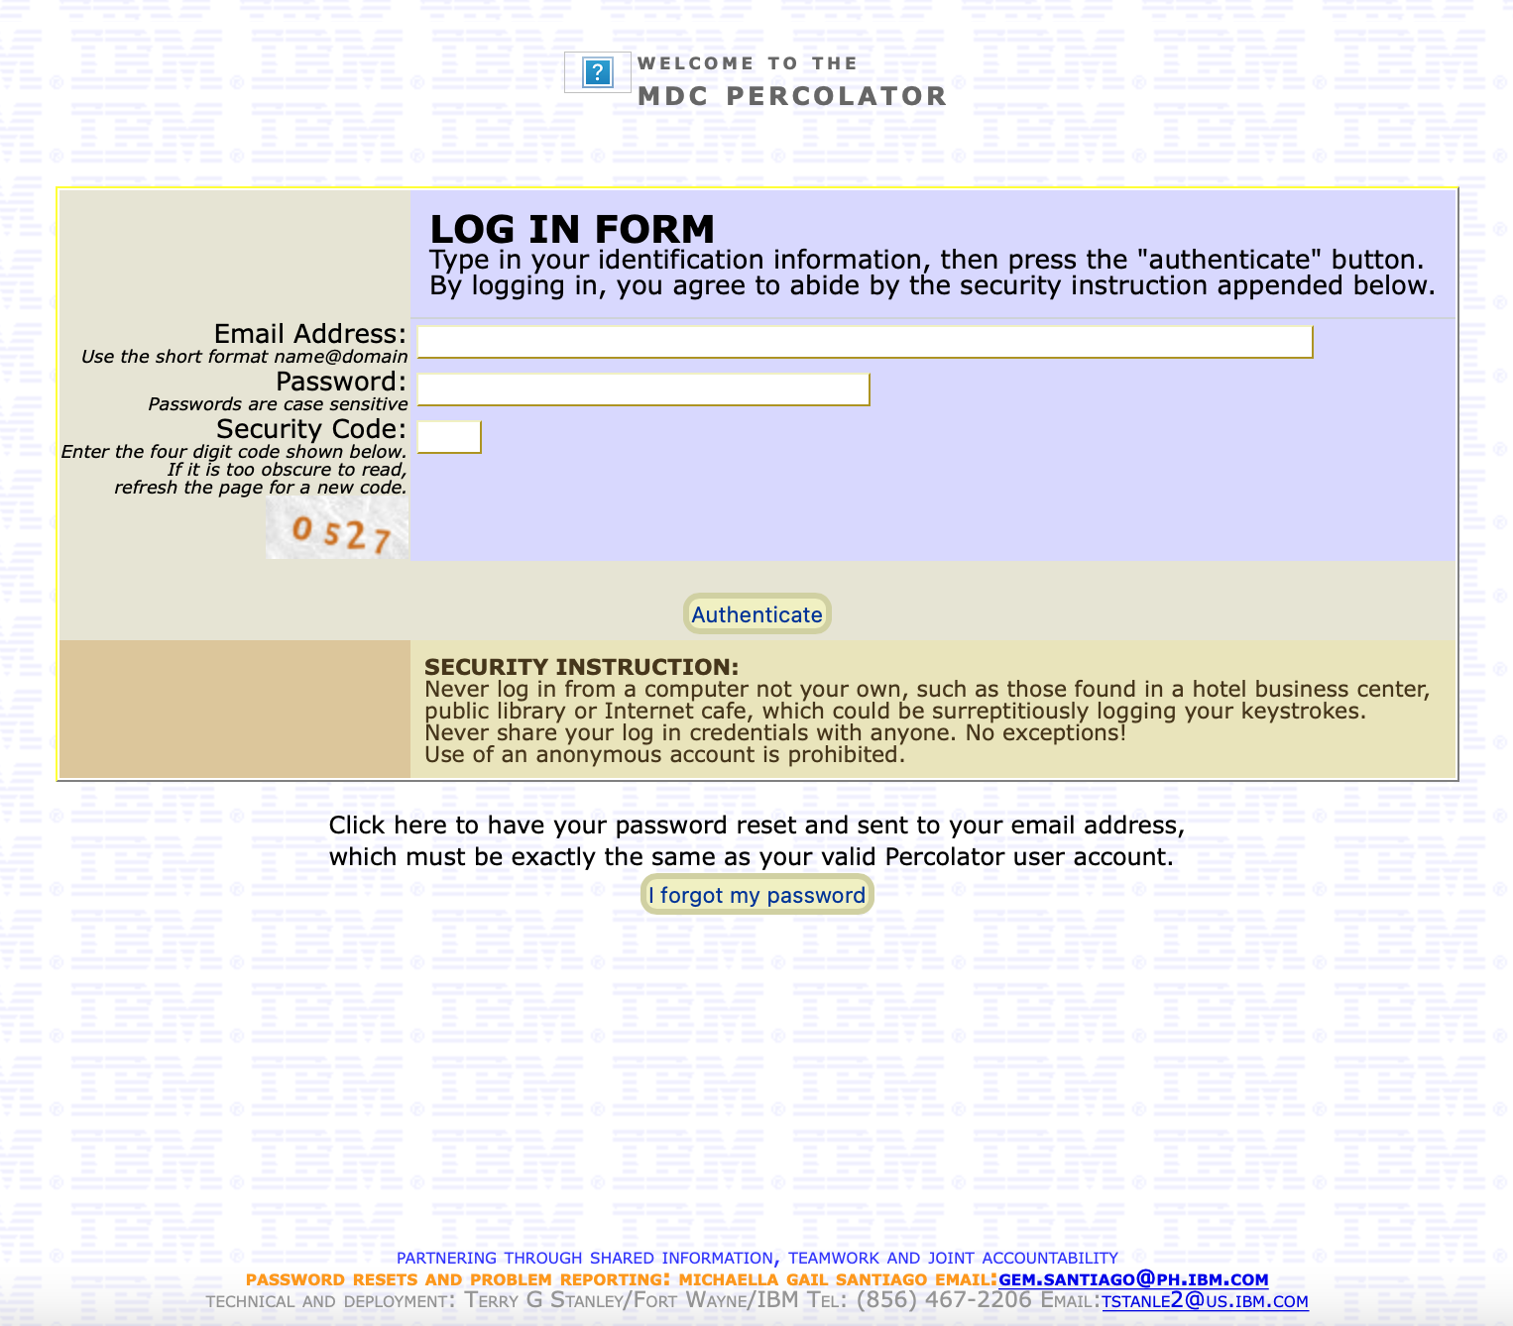

MDC Percolator Tool
Walkthrough
Notes:
We’ll now move to a brief walk-through on using the MDC Percolator tool.
This is the MDC Percolator tool log-in page.
To request for access to the tool, please send an email to phqms@ph.ibm.com with the approval from your BluePages Manager. Note that while your username will be your IBM email address, you will need to assign a unique password for MDC Percolator.
The MDC Percolator is a secured website, and you will need to log-in to the tool at least once every 60 days to prevent your password from expiring. Once your password expires, you need to send a password reset email request to the QMS Team.

Slide 19
Change Management Workflow
I. Changes with PCR
II. Work At Risk
General Information
General Information
Change Details
Work At Risk
Implemented
Implemented
On hold/Withdrawn
Notes:
Let’s first talk about the workflow of process changes entries in the MDC Percolator tool.
When logging in changes with PCR, you are to fill-out the General Information Section, Change Details Section, and Implemented Section.
If you are logging in a process change under Work at Risk, please fill-out the General Information Section, Work at Risk Section, and Implemented Section.
The On hold/Withdraw section will be used only if your entry was put on hold or withdrawn prior full approval or implementation.

Slide 20
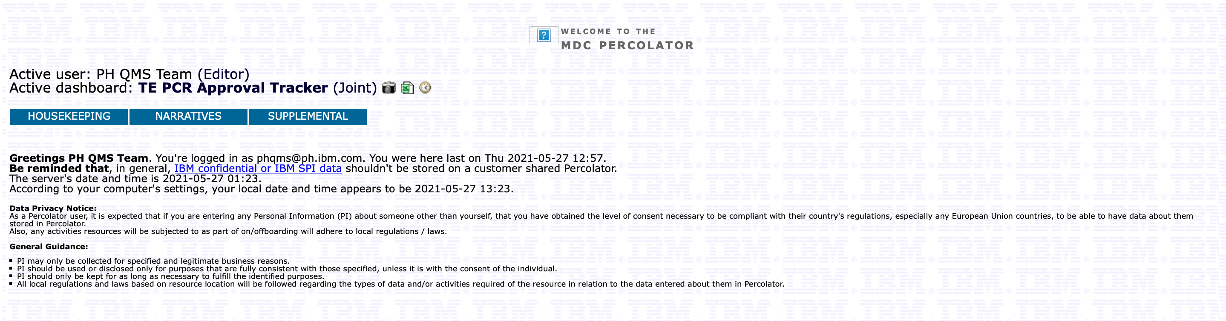
Dashboard Page
Notes:
After logging in, you will be taken to the dashboard page you have been given access to, depending on your tower. For this walk-through, we will navigate through the T&T Dashboard.
The top row boxed in blue are called tabs which will allow you to perform specific activities in the tool.
Note that when creating an entry you need to have all the details pertaining to your process change ready.

Slide 21
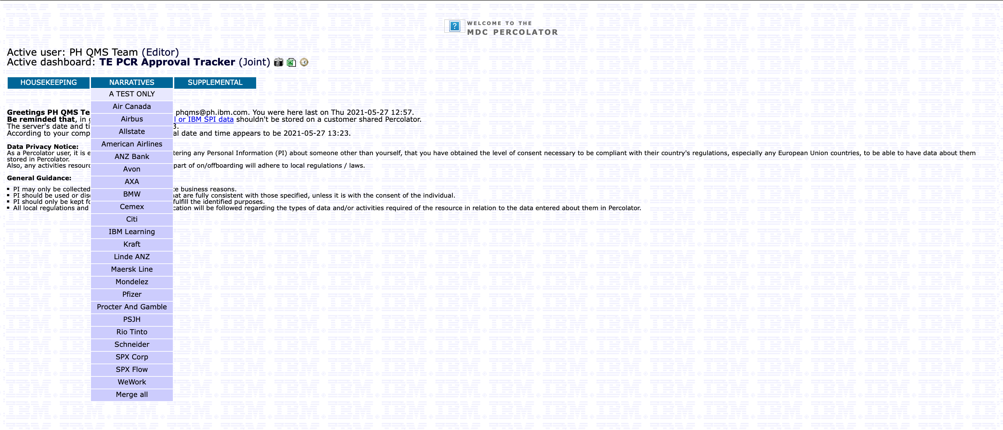
Logging a Change Entry
1. Select your account name under the Narratives menu tab.
Notes:
To create an entry, click the Narratives tab and access your account’s narratives page by clicking on your account name. For this walk-through, we will use the A TEST ONLY account, which is what we use for sample entries.

Slide 22
Logging a Change Entry
2. Click “Add New Line Item to This Section” link under General Information.
Notes:
The next page will show you all your account’s existing entries under their specific section so do not be confused with the contents of the page.
To create a new entry, click the “Add New Line Item to This Section” link which you will find on the top part of the page, under the General Information section.

Slide 23
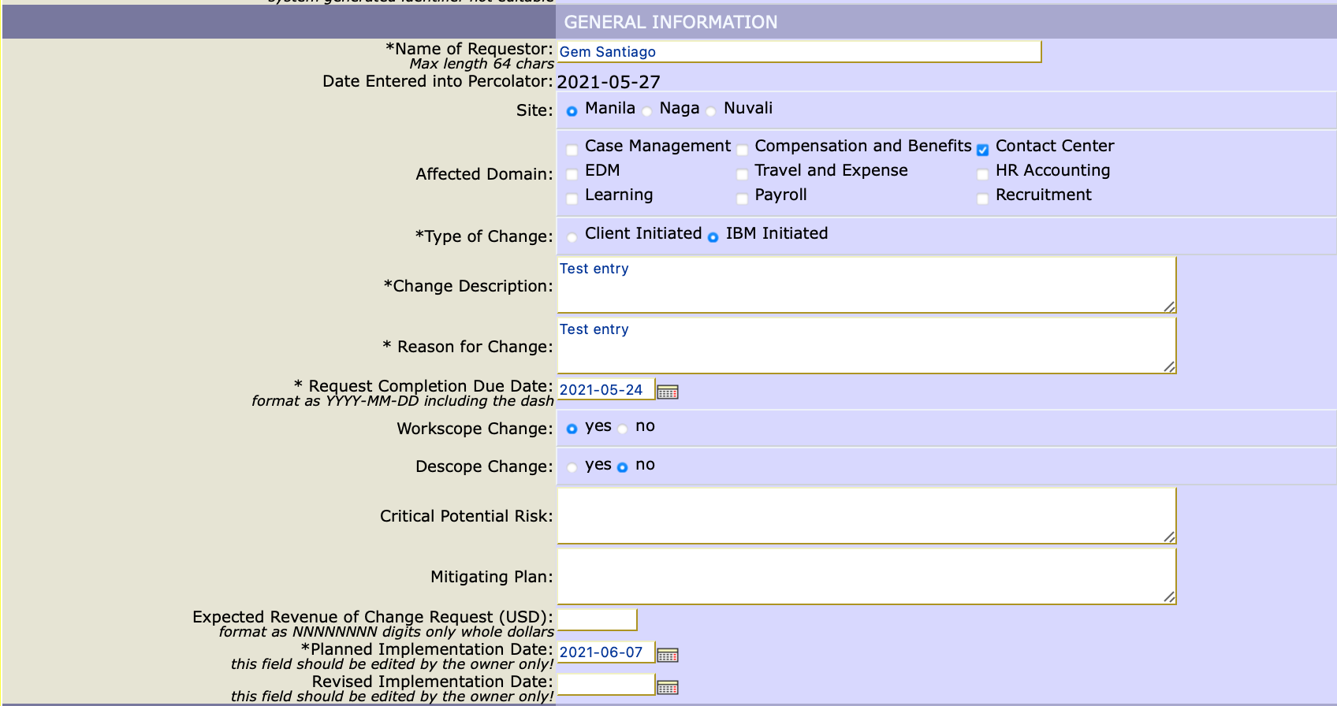
Logging a Change Entry
3. Fill out the General Information Section.
Notes:
The next page will show you the sections you will need to fill-out. All items marked with an asterisk are required fields.
Under General Information you are to input basic details about your account and team, starting with the name of the requestor who is the creator of the entry. Identify your site, your domain, and the type of change being logged. Input a short description of the change and specify if you are logging in a workscope change or descope change. You may also input details for the potential risk, mitigating plan and expected revenue.
You will need to input the planned implementation date of your change.
In case the planned implementation date will need to change, you can go back to your entry and fill-out the revised implementation date field.

Slide 24

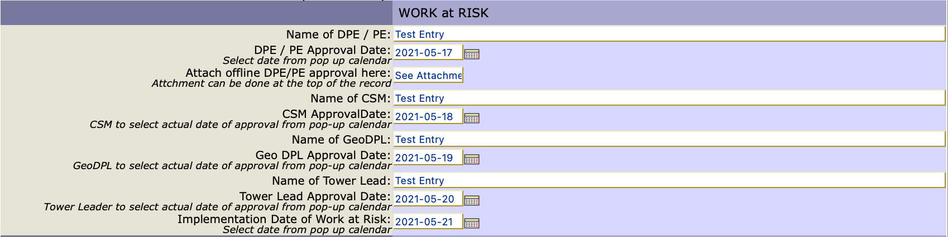

Logging a Change Entry
3.1 Fill out the necessary information under Work at Risk if applicable.
Only accomplish this section if you are logging a work at risk
Attach files here
Notes:
If you are logging a Work at Risk entry, fill-out the Work at Risk section directly below the General Information section.
Note that if you are not using the T&T Tower Dashboard, you will see Operations Manager in place of the CSM field.
Geo DPL name and approval date is also only applicable to the T&T tower.
To attach offline approvals or other files to your entry, find the Paperclip icon at the top of your Narrative, beside the title of your entry.

Slide 25
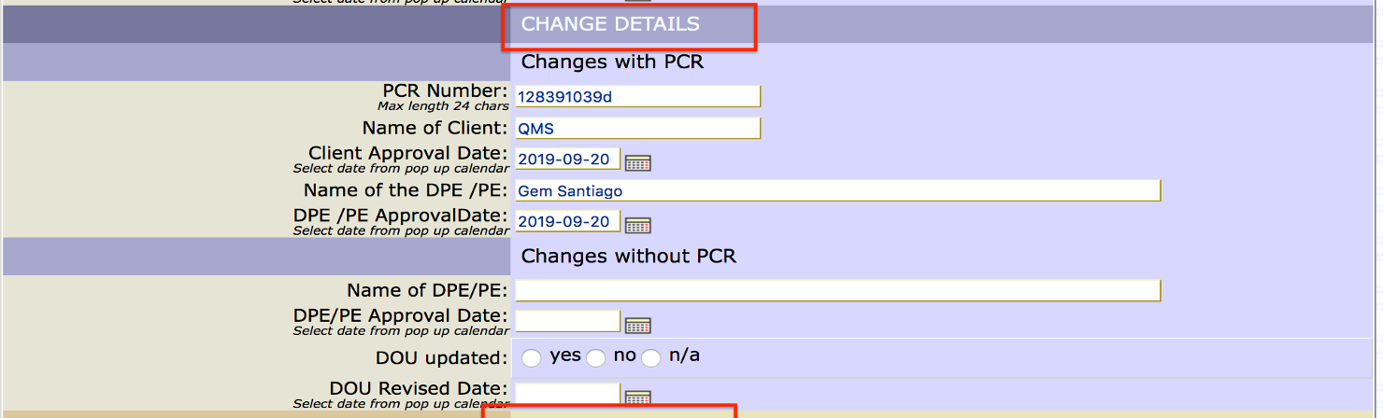
Logging a Change Entry
3.2 Fill out the necessary information under Change Details.
Notes:
To log entries which are not under Work at Risk, proceed to the Change Details Section.
Changes with PCR is where you log PCR details of your Major Changes like the PCR number, name of your client & DPE, and their approval dates.
You will fill-out the Changes without PCR if you are logging in a Minor process change, or if instead of PCRs, you maintain a DOU or Document of Understanding with your client.

Slide 26
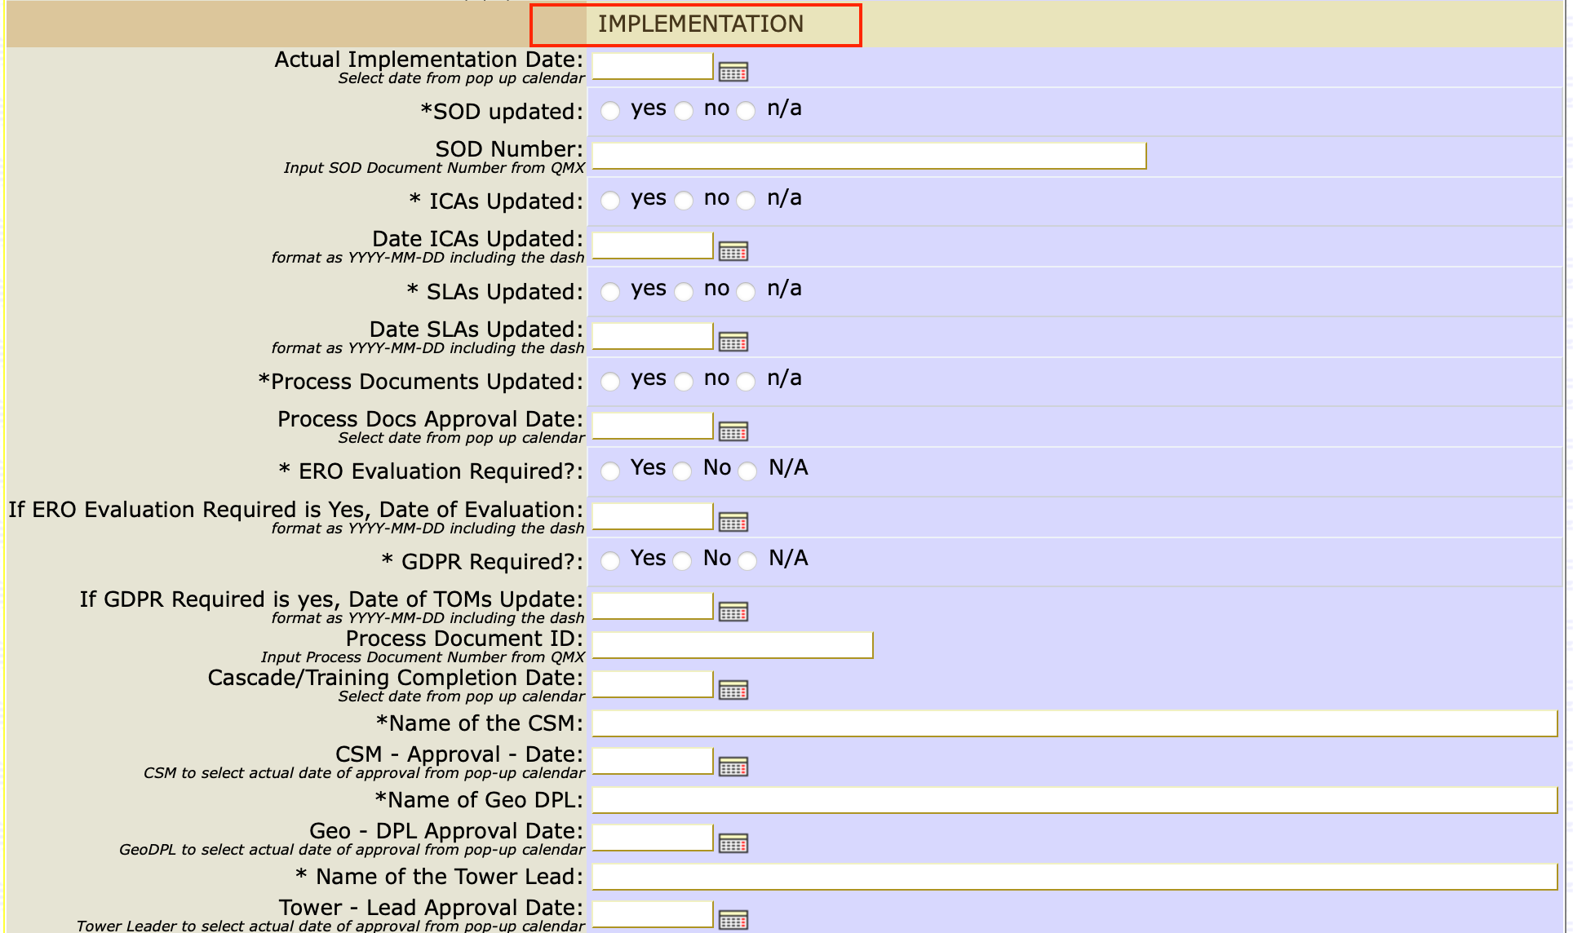
Logging a Change Entry
3.3 Fill out the necessary information under Implementation.
Notes:
Proceed to filling-out the implementation details of your entry. Again, remember that all items with asterisks are required fields.
Those not from T&T Tower, the CSM fields will be showing as Operations Manager on your dashboards, and GeoDPL information will not be visible to you.

Slide 27
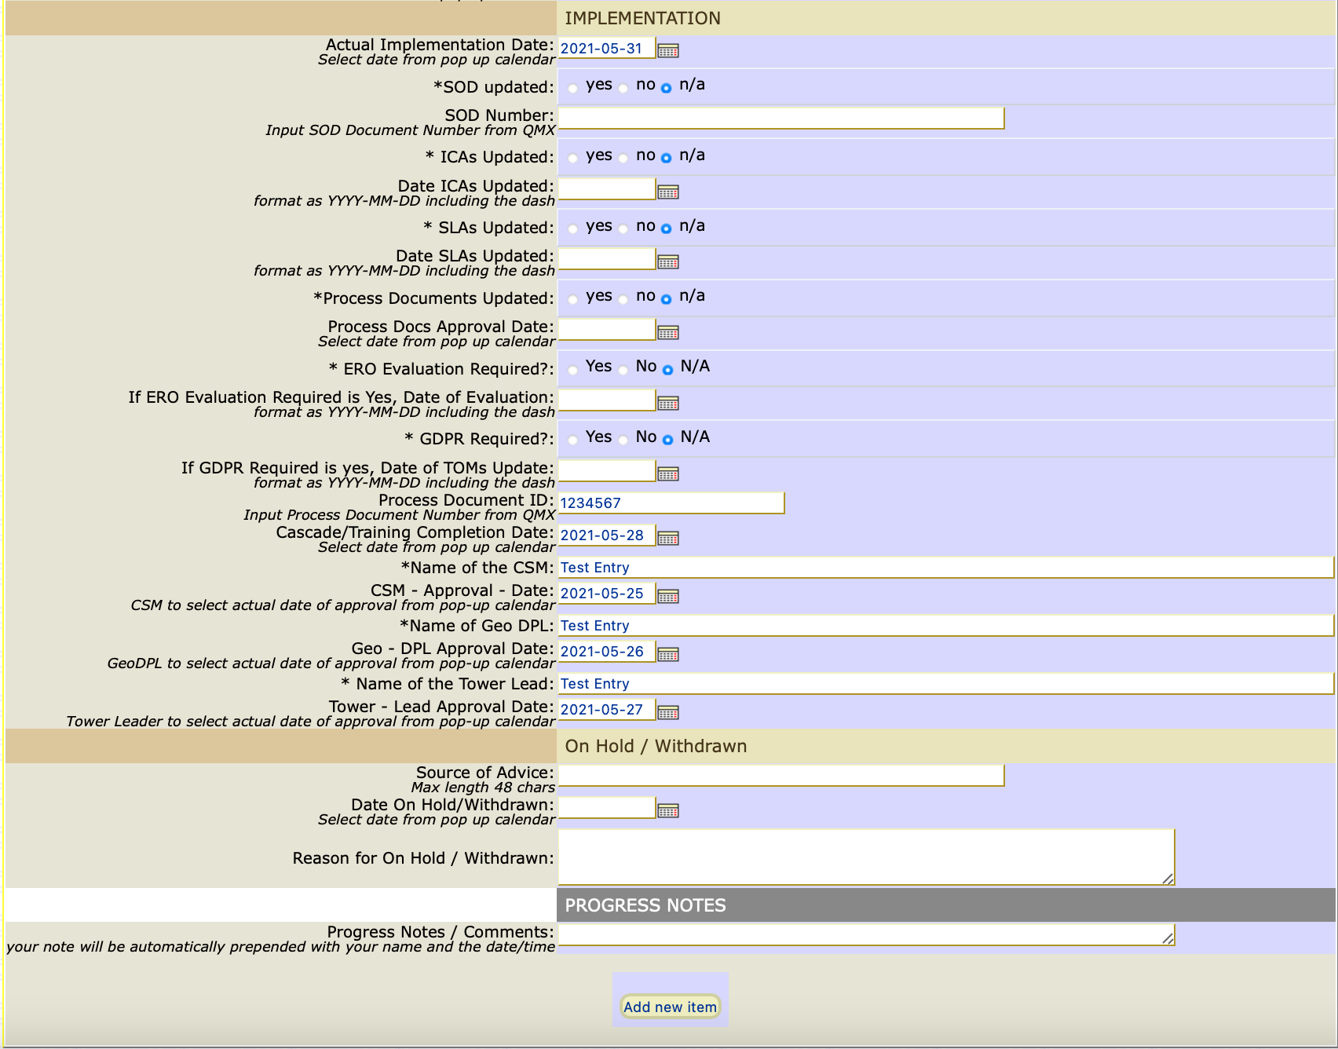
Logging a Change Entry
4. Click “Add New Item” at the bottom part of the page to save the change entry.
Notes:
After filling-out all the required information, click the “Add new Item” button at the bottom of the page to save your entry.

Slide 28
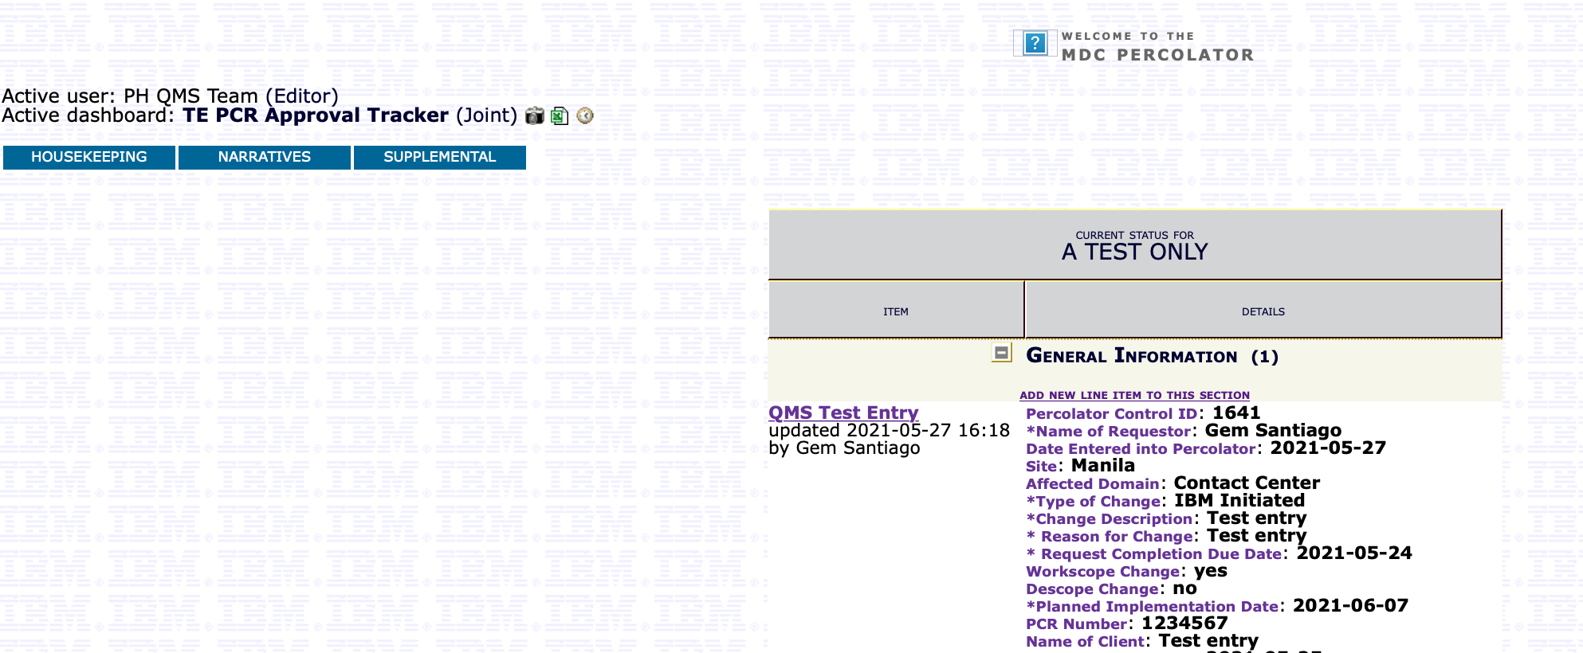
Submitting entry for approval
5. Go back to your account homepage and then click the title of the change entry you just created to open the form again.
Notes:
After clicking on the “Add new Item” button, go back to your account’s Narratives page and click on the name of your entry to open it.

Slide 29
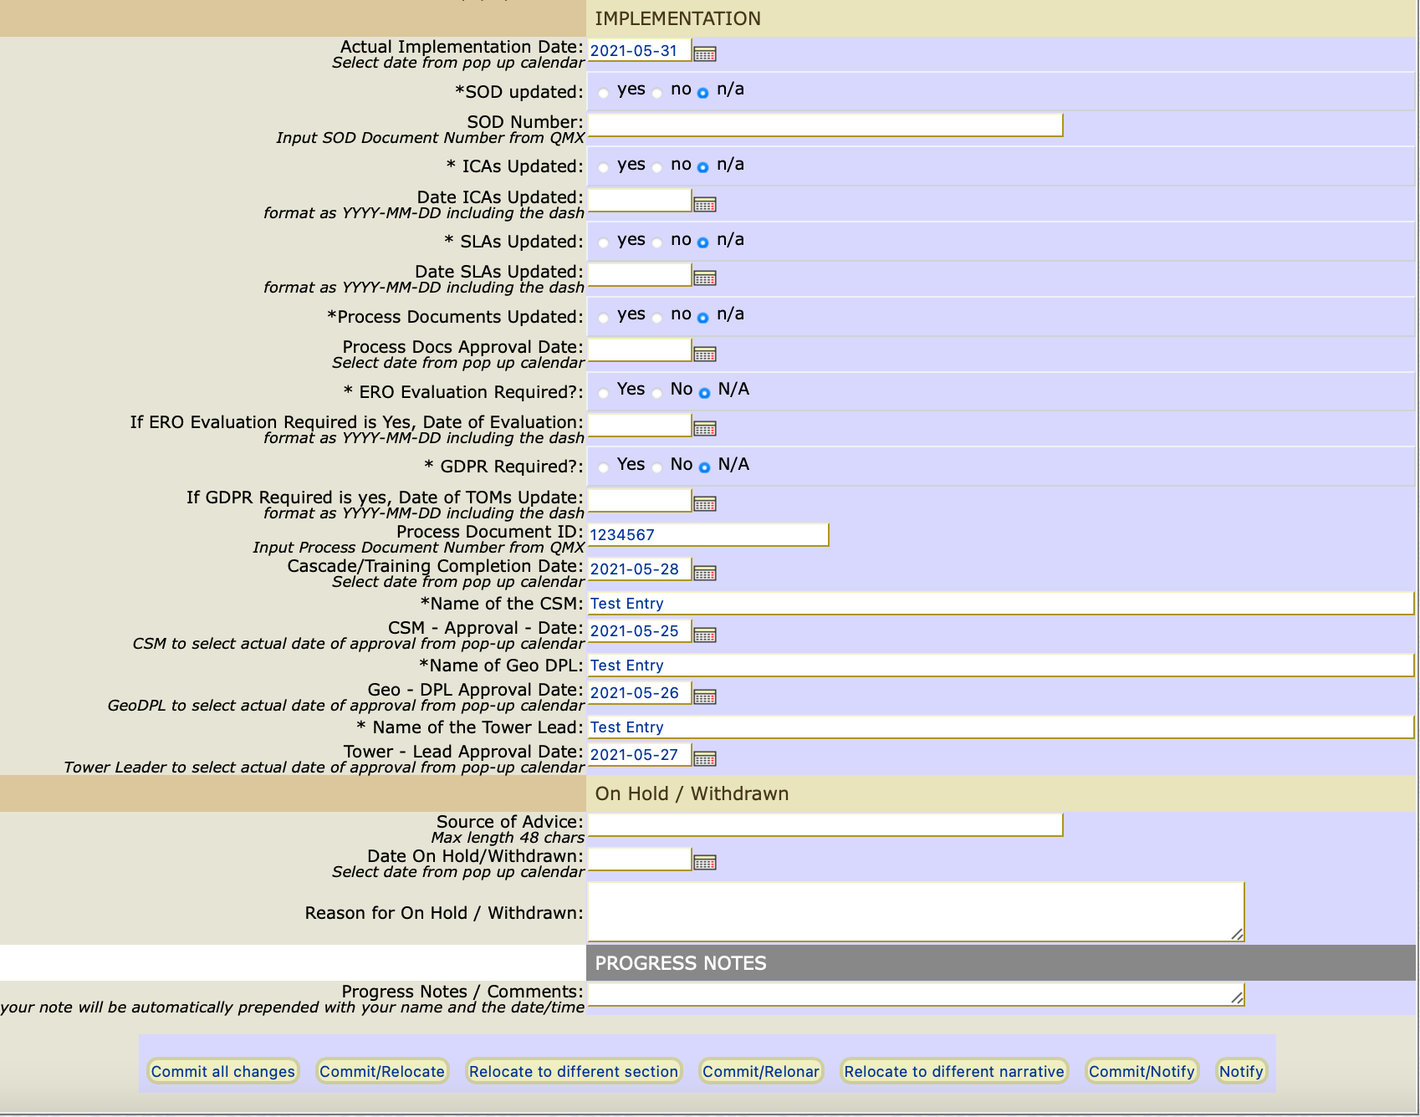
Submitting entry for approval
6. At the bottom part of the form, click “Commit/Notify” button.
Notes:
Review your entry and click the “Commit/Notify” button at the bottom of the page to route it for approval.

Slide 30
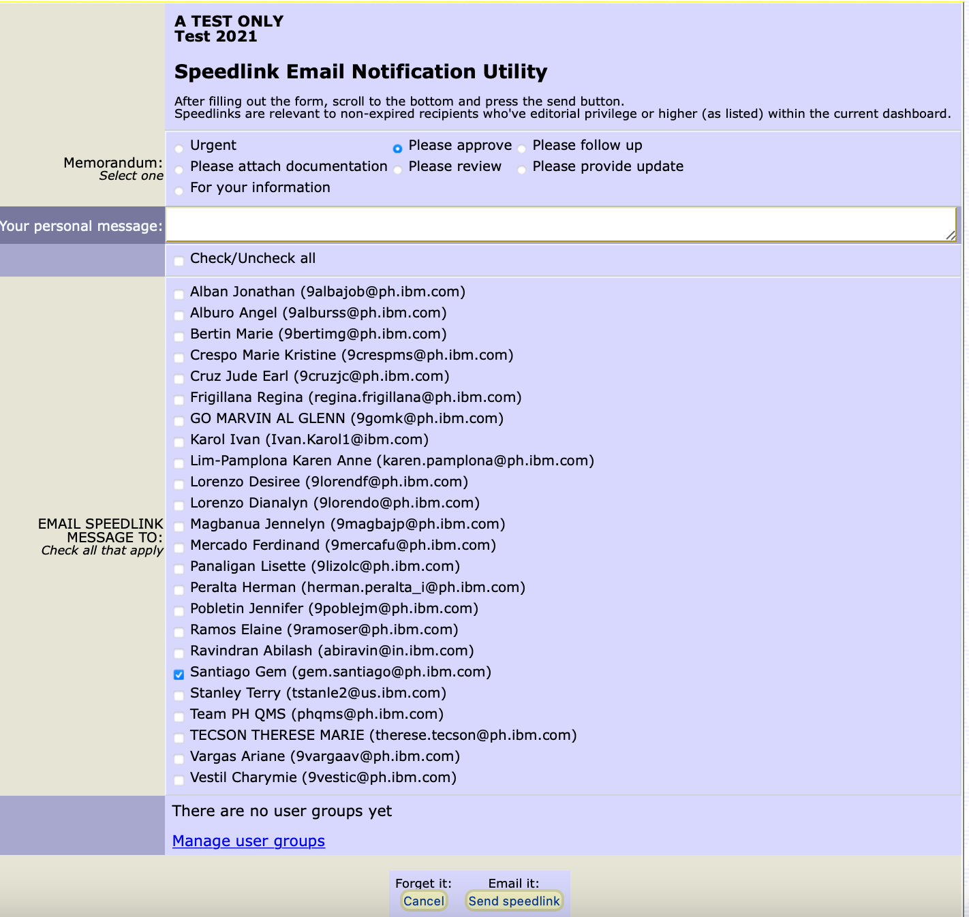
Submitting entry for approval
7. Tick “Please Approve” in the memorandum section.
8. Tick all the names of the required approvers in ”Email Speedlink Message To” section.
9. Click “Send speedlink” button to submit for approval.
Notes:
You will then be taken to the “Speedlink Email Notification Utility” page.
On the Memorandum section, you may select the “Please Approve” button for it to be added to the subject line of the email notification to the approver. Select the name/s of your approvers from the Email Speedlink Message to section, then click the Send Speedlink button at the bottom of the page to start the approval process.
In case you cannot find the name of your approver, it’s either they do not have access yet to the MDC Percolator tool or their access has expired. Immediately notify your approver to send an email to the QMS team for access or password reset request.

Slide 31
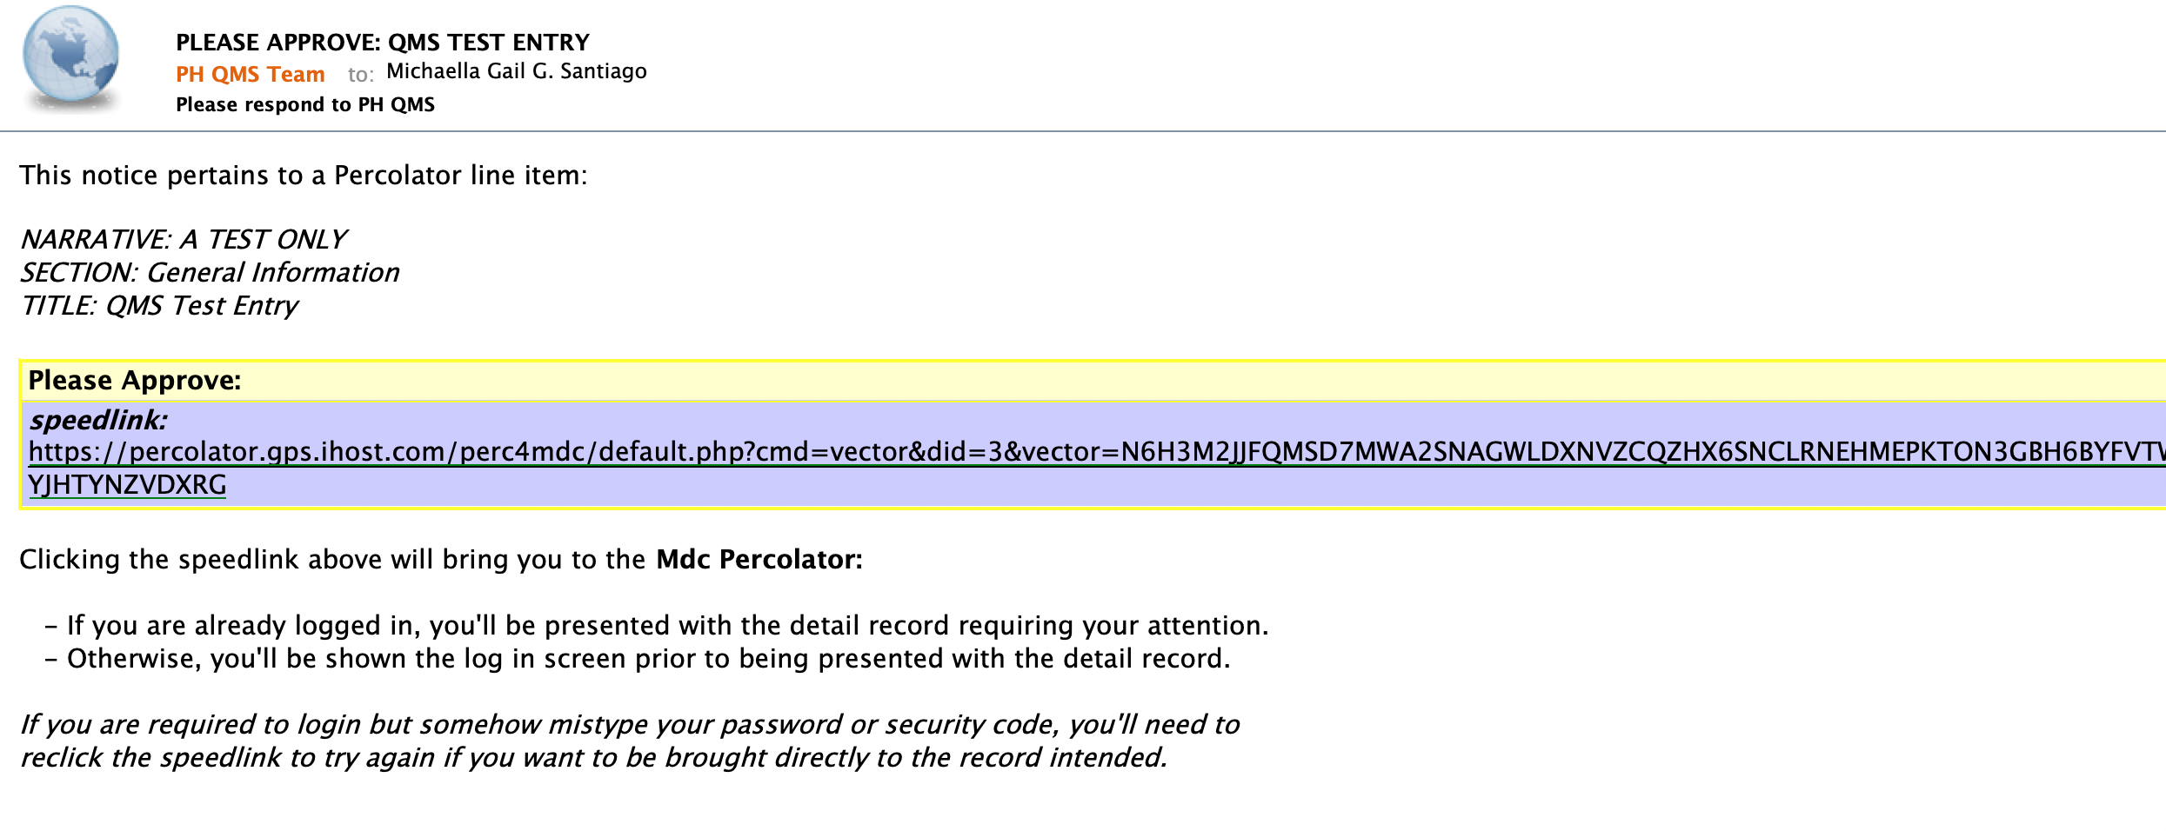
Approval
10. Approver/s should click the speedlink provided in the email.
Notes:
Approvers will receive this email notification. They simply need to click on the link provided to access the entry in the MDC Percolator tool.
If they are not yet logged in to the tool, they will first be taken to the log-in page.

Slide 32
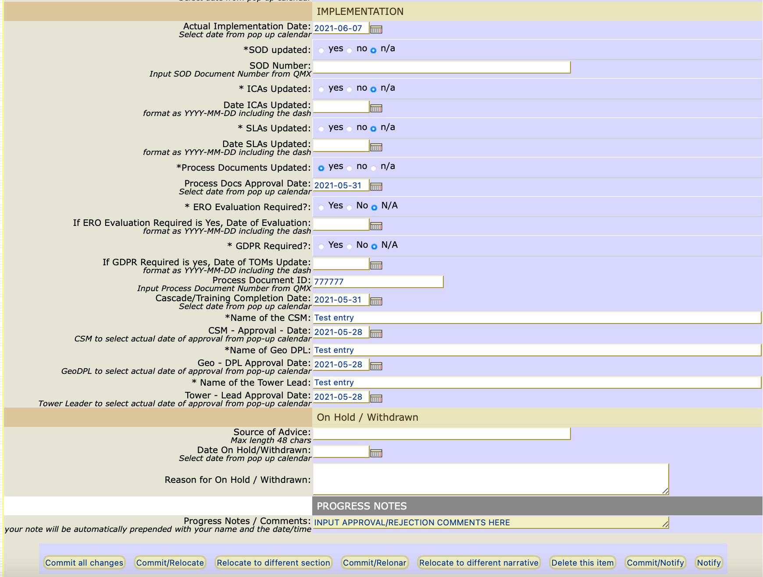
Approval
13. Approvers to indicate “Approved/Rejected” notation in the Progress Notes section.
14. Approvers to click “Commit/Notify” button to notify author if entry is approved or needs to be updated/revised
Notes:
Approvers should review all the information provided in the entry. Once ready to approve or reject, Approver should fill-out the “Progress Notes” section with the approval or rejection comments.
Click the “Commit/Notify” button to proceed.
Again, those not from T&T Tower, the CSM fields will be showing as Operations Manager on your dashboards, and GeoDPL information will not be visible to you.

Slide 33
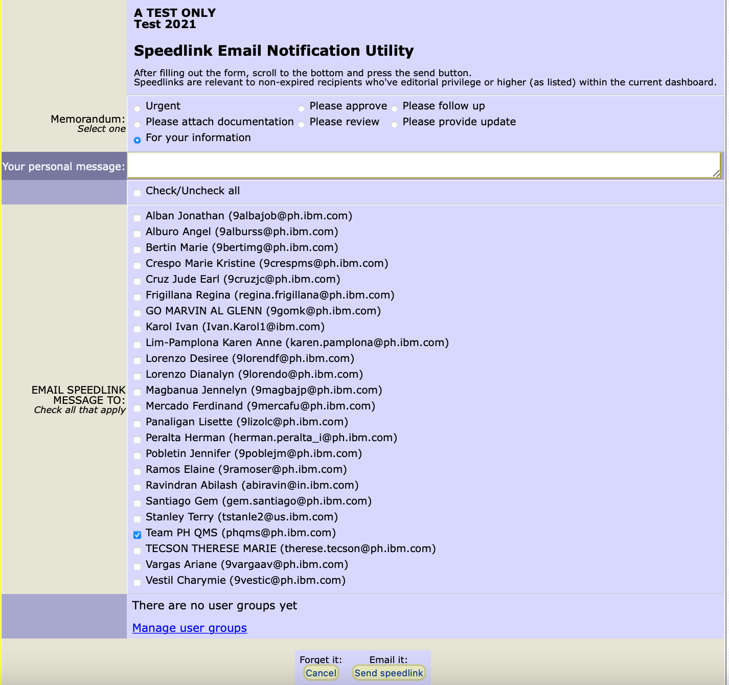
Approval
15. Tick the kind of memorandum to be sent back to the author.
16. Tick all the of the Initiator in ”Email Speedlink Message To” section.
17. Click “Send speedlink” button to route to the Initiator for notification.
Notes:
The approver will then be taken to the Speedlink Email Notification Utility window. They need to select the appropriate memorandum to be used, and the name of the Author of the entry from the Email Speedlink Message to section. Click the Send Speedlink button to notify the author of the entry of the approval or rejection comments.

Slide 34
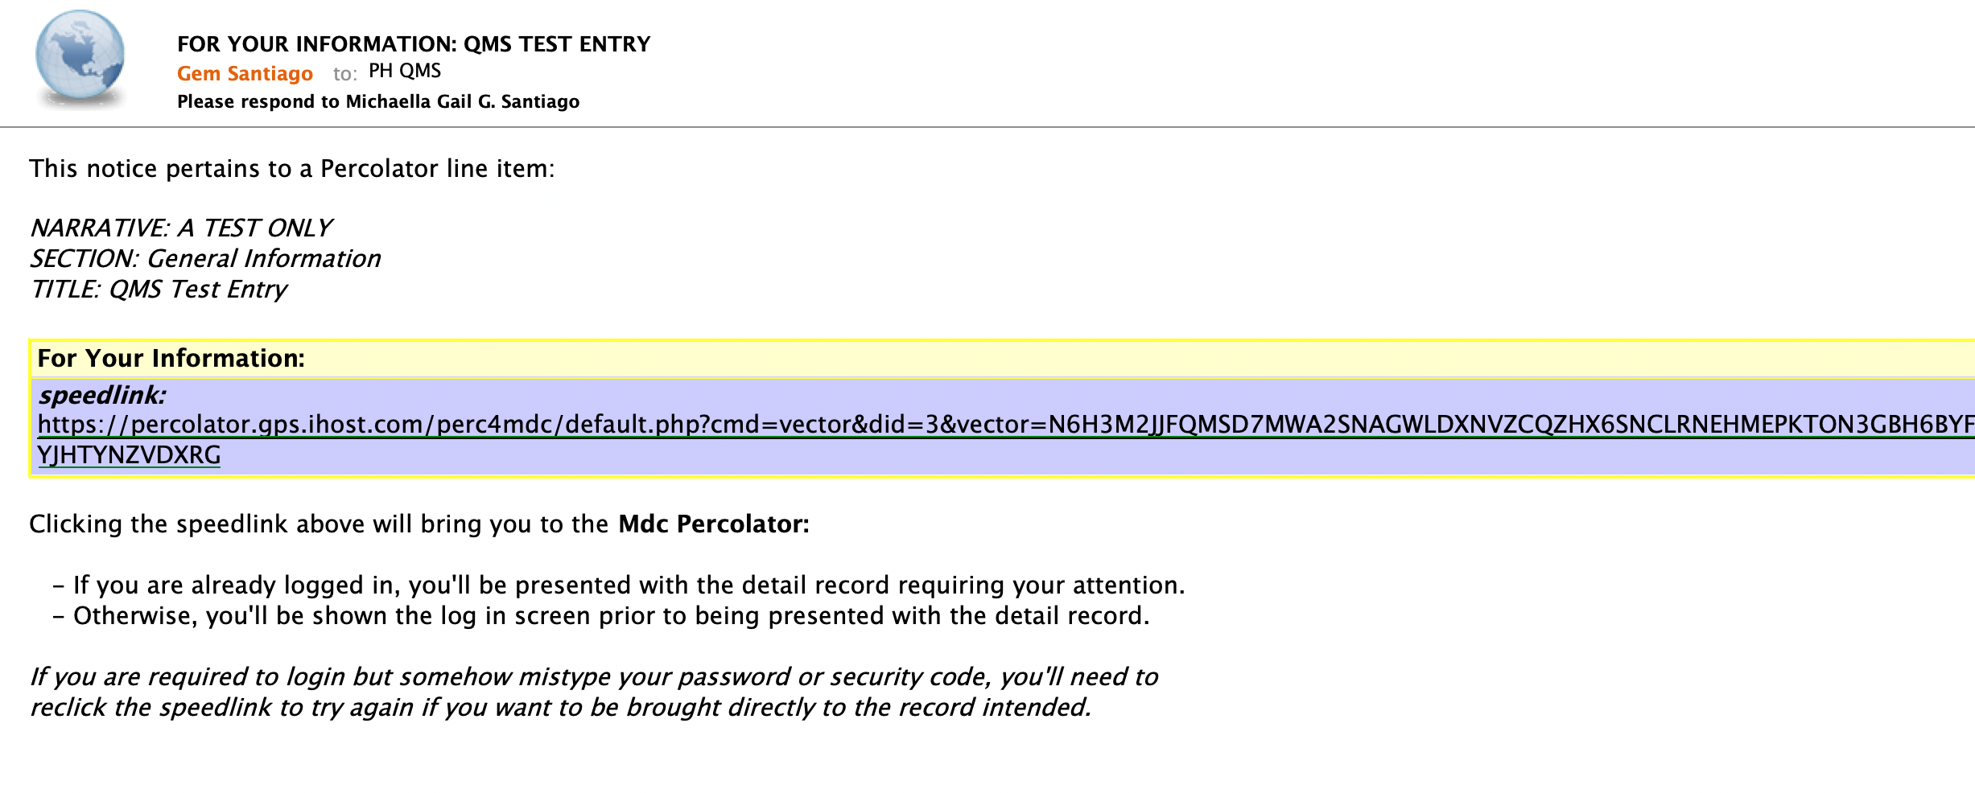
Closing out an Entry
18. Author should click the speedlink provided in the email notification.
Notes:
Authors will receive this email notification. They simply need to click on the link provided to access the entry in the MDC Percolator tool.
If they are not yet logged in to the tool, they will first be taken to the log-in page.

Slide 35
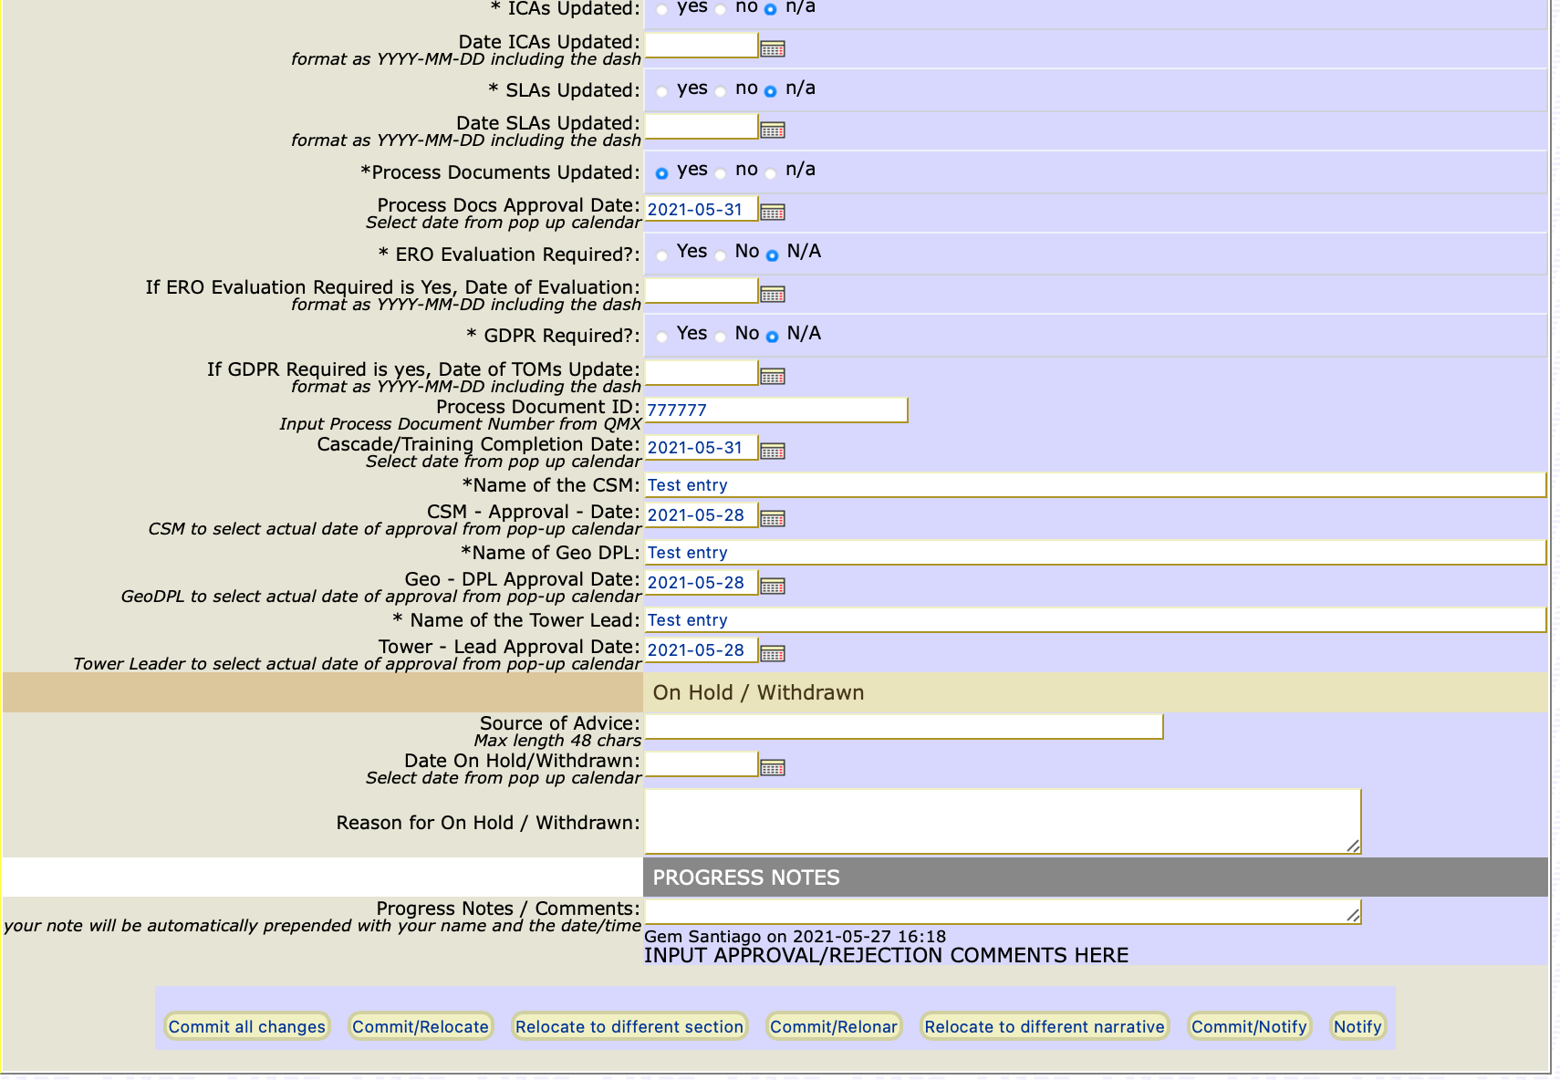
Closing out an Entry
19. If entry is rejected, Author should perform needed updates then re-route entry for approval by clicking the “Commit/Notify” button.
20. If entry is approved, Author should click “Commit/Relocate” at the bottom of the form to close out the entry.
Notes:
The author will need to check the comments provided by the Approver under the Progress Notes section.
If entry is rejected, Author should perform needed updates then re-route entry for approval by clicking the “Commit/Notify” button.
If entry is approved, Author should click the “Commit/Relocate” button to move the entry to the implementation stage and close it out.

Slide 36
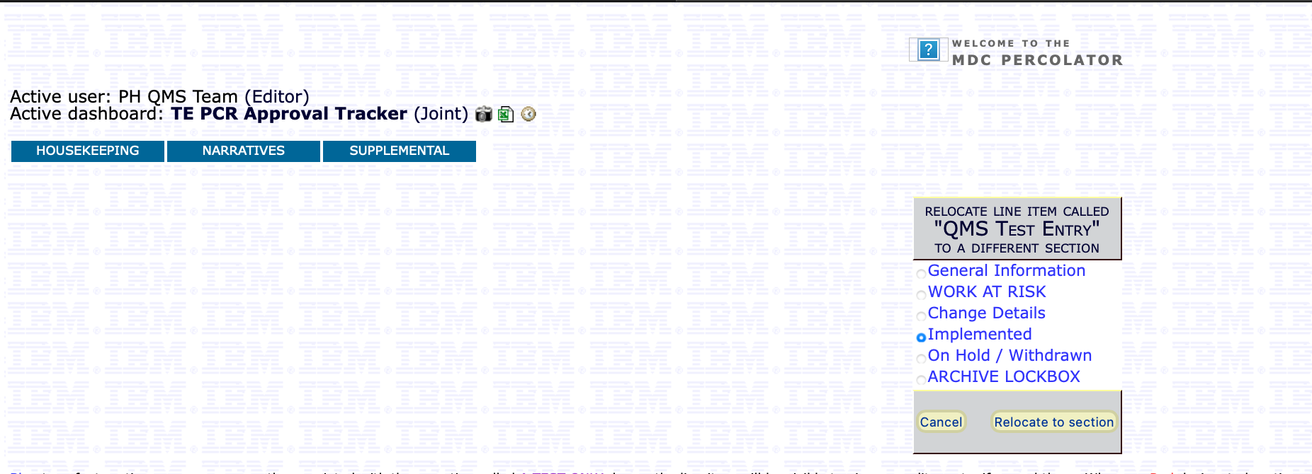
Closing out an Entry
21. If entry is approved and fully implemented, tick “Implemented” and click “Relocate to Section”.
Notes:
Fully approved and implemented process changes are to be relocated to the Implemented Stage.
Other stages may be selected as needed. For example, if you have only filled out the entry up to Work at Risk and routed it for approval, you may relocate your entry to that stage first.
You are free to fill-out your entry and route it for approval on a “per stage” basis.

Slide 37
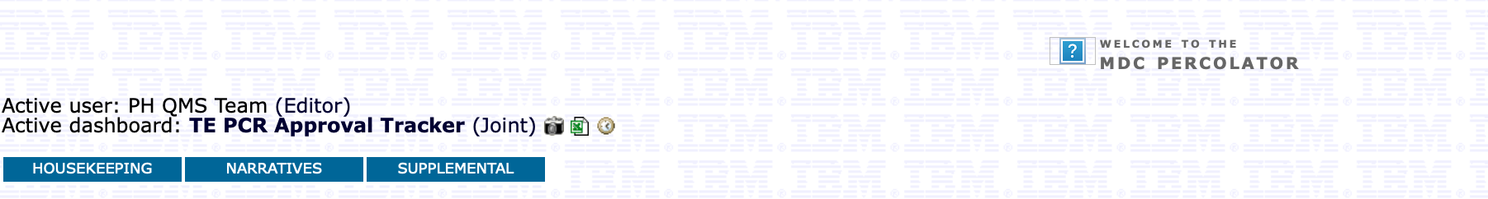
Other Functions
Generates a snapshot of the selected Narratives in the active Dashboard. You will receive the report in .xls format via email.
Reporting
For viewing recent History report
Receive via email a pdf-formatted snapshot report of the Dashboard’s contents
Notes:
The MDC Percolator is also able to provide you with reports on your Narratives.
The camera icon will let you receive an email report with your dashboard’s contents in pdf format.
The MS excel icon will give you an excel report of your Narratives via email.
The information icon will show you the most recent reports you have generated.

Slide 38
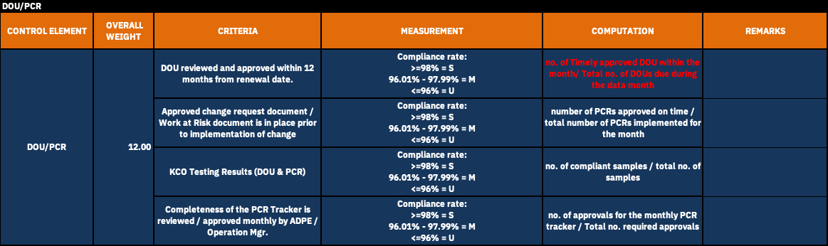
References
RISC Management Scorecard
Notes:
Approvals of your PCRs and DOUs are being monitored by the Business Controls Team under the RISC Management Scorecard which is reported to the Center Leadership Team. Refer this slide for details on how they compute for your rating.

Slide 39
References
KCO 716: WORK SCOPE CHANGES
Ensure delivery work scope and process changes are properly logged, tracked, approved prior to implementation in accordance to the change management process and/or the local work scope changes process. Ensure that changes impacting MOR requirements/current status led to updating the MOR to reflect the changes. Ensure ICAs is updated, if impacted by the change. As well ensure that Delivery Process Documentation, SODs, CPs are in place prior to implementing the change. Ensure that ERO and DPRC requirements are properly assessed and adhered to.
KCO 716 Attributes:
716a. Logged and tracked
716b. Approved
716c. Validate DOU/Matrix of responsibilities and ICAs Exist
716d. Validate Delivery Process Documentation
716e. Validate Data protection Regulation applicability and subsequent actions required per the applicability agreement.
716f. Export Regulation, Validate for the new scope of work, vendor and/or new delivery employee
716g. At year end, if there were no work scope and process changes executed during the year, tester will enter 1 sample at the end of the year with no defect that demonstrates this
For more information on KCO 716 Test Attributes and Requirements, reach out to your Account’s Business Control Focal.
Notes:
Likewise, Compliance & Testing team also monitors your adherence to the Work scope changes controls. This slide shows you the testing attributes they use during their audit.
Remember that you should always be audit-ready when it comes to documenting your process changes.

Slide 40
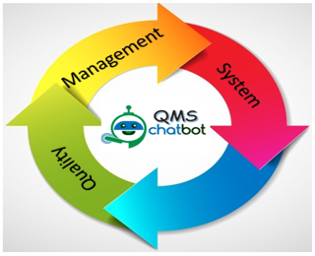

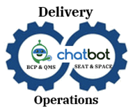
QMS Chatbot
Please use the QMS Chatbot for FAQs on the following:
Access requests for QMS Tools (MDC Percolator, QMX)
QMS Policies
QMS Training
SOC 1
https://cognitiveassistant.in.edst.ibm.com/#/
Notes:
You may also use our QMS Chatbot for frequently asked questions on access to QMS tools, policies, training schedules, and SOC 1.

Slide 41

END OF TRAINING
Thank You!
Please email your questions to:
phqms@ph.ibm.com
Notes:
You have reached the end of the training. Thank you for your time. Any questions or clarifications should be sent to our functional mailbox: phqms@ph.ibm.com.

Slide 42
Revision History
Version Number | Effective Date | Summary of Changes | Author
1.00 | 8-March-2017 | - Initial version. | Shara Hernando
2.00 | 16-July-2018 | - Removed “(will be tracked separately by the account focals and will not be loaded in Percolator)” from #3 on Slide 4. | Michaella Santiago
3.00 | 16-April-2019 | Changed the Percolator Walkthrough Process based from the updated change management workflow. Updated all screenshots Updated Policy: Definition of Change Management and Percolator | Maine Abangan
4.00 | 20-September-2019 | Added Training Objectives Updated some screen shots and formatting | Maine Abangan, Gem Santiago, Oz-Bee Quinto
4.01 | 9-March-2020 | Minor change: Removed Maine Abangan from Slide 1 | Michaella Santiago
4.02 | 27-March-2020 | Minor change: added visuals and animations | Michaella Santiago
4.03 | 6-Apr-2020 | Minor change: added References Slides for RISC Management Scorecard and KCO Attributes | Michaella Santiago
4.04 | 26-MAY-2020 | Minor change: added slide on QMS Chatbot | Michaella Santiago

Slide 43
Revision History
Version Number | Effective Date | Summary of Changes | Author
4.05 | 14-Jul-2020 | Added QMS Specialist name on title page Added knowledge check slides | Michaella Sasntiago
4.06 | December 15, 2020 | Minor change: Changed the theme of the deck | Sydney Gesmundo
4.07 | January 13, 2020 | Minor Change: updated slide on KCO 716 Updated screenshots of slide with Implementation details | Michaella Santiago
4.08 | April 6, 2021 | Minor Change: Removed QMS Specialist from Title Page. | Michaella Santiago
4.09 | April 30, 2021 | Minor Change: Fixed arrows’ format on Slides 33 & 36 | Michaella Santiago
5.00 | November 25, 2021 | Major Change: Added recordings and fixed formatting | Michaella Santiago
6.00 | April 1, 2022 | Minor Change: Updated slide on KCO Requirements | Michaella Santiago

